Slide 1
Lab 3 Composite, Strategy and Decorator Patterns -- 02
Please download the corresponding materials

Slide 2
Before introducing the lab, please pay attention to the following issues:
1, the due (02/14/2018), next Wednesday;
2, demo: any labs or office hours before the deadline (redemo is okay); the lab next Thursday (02/15/2018) (redemo is not allowed)
3, submission: push code on Github repo, screenshot of your Github on iLearn
4, introduce: Decorator Pattern

Slide 3
Decorator Pattern
Based on Composite Pattern
Decorator Class: further calculate on the value of each tree (Base*)
Ceil Class: #include <math.h> or #include <cmath> and call ceil(value) – get smallest integer that is no less than value
Floor Class: floor(value) – get the largest integer that is no greater than value
Abs: abs(value): abs(value) – get the absolute value

Slide 4
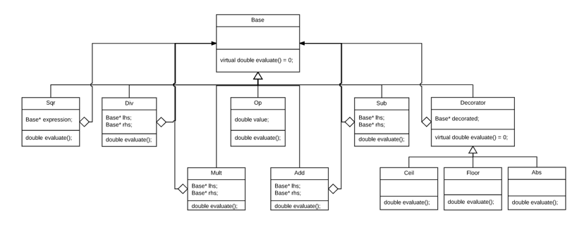
Decorator Pattern

Slide 5
Testing Program
Include all three decorator classes, Ceil, Floor and Abs
Test combinations of decorate operations
(e.g use floor class to get a temporary result, and call abs to get the
absolute value of this temporary result:
Base* tree;
Floor* f = new Floor(tree);
cout << f->evaluate() <<endl;
Abs* a = new Abs (f);
cout << a->evaluate() <<endl;
)

